Slide 1
Chapter 8: Understanding Decision Trees

Slide 2
Contents
Introduction to Decision Trees
Decision Trees as a Model
Benefits of Decision Trees
Decision Tree Growth
Decision Tree in Knowledge Studio
Decision Tree Considerations
Improving the model
Viewing a Decision Tree in Knowledge Studio

Slide 3
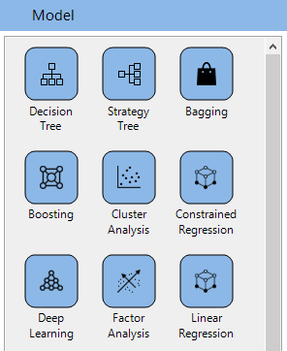
Introduction to Decision Trees
Access the Decision Tree node from the Model Palette
Decision trees provide a visual way to represent data
There are many applications for using Decision Trees:
Model building / Complementary modelling
Segmentation
Exploration
Illustrating relationships
Versatile technique accommodating categorical or continuous dependent variables
Independent variables can be of any type
No assumptions about data distributions
Notes:
The decision tree node can be accessed from the Model palette. Decision trees are a type of modeling technique used for a various data science initiatives. Decision trees could be used for model development on their own, or could be used alongside other modeling techniques to compliment them. For example, decision trees can be used for segmenting the population, and other modeling techniques such as logistic regression and neural networks can be used to build models for each of the segments. Not only are decision trees great for modeling outcomes, but they can also be used to explore unfamiliar datasets. Decision trees could be used to model both categorical or continuous dependent variables and independent variables used in decision tree models can be of any type.

Slide 4
Introduction to Decision Trees
A typical decision tree classifies data into homogeneous groups by successively segmenting data
An objective is usually defined prior to building the decision tree. In this example, the objective is to identify those who are most likely to respond (‘Yes’ group) to a marketing campaign
DV Statistics
Entire Population
Split Attribute
Depth = 1
Depth = 2
DV Statistics
Sub Population

Slide 5
Introduction to Decision Trees
The DV statistics on the entire population show that 23.82% of the population responds ‘Yes’ to a marketing campaign and 76.18% responds ‘No’ to a marketing campaign
The variable relationship is used to split the entire population into subgroups with similar behaviour
DV Statistics
Entire Population
Split Attribute
Depth = 1
Depth = 2
DV Statistics
Sub Population

Slide 6
Introduction to Decision Trees
Looking at the parent node, we see 23.82% of the population responds ‘Yes’ to the marketing campaign
Looking at the Husband/Wife Segment, we see that 45.11% of the records that fall in that group respond ‘Yes’ to the marketing campaign
Parent or Root Node
Split Attribute
Parent
Depth = 1
Depth = 2
Child
Child Nodes or Leaf or Terminal Nodes

Slide 7
Introduction to Decision Trees
Some important terminology to remember:
The first node in a decision tree is called a root node. It contains all the records in the dataset
Any node split further is a parent node
A node built from the parent nodes is called a child node
This means the Root node can be also called a parent node if it is split further
Any node that does not undergo further splitting is called a terminal node
Root Node
Parent and Child Nodes
Parent and Child Nodes
Terminal Nodes

Slide 8
Decision Trees as a Model
Think of a decision as a set of IF THEN ELSE rules. From the previous slides, we saw that 23.82% represents the overall ‘Yes’ response rate to the marketing campaign.
By segmenting the data further, we can see that:
If relationship is either Husband or Wife, then there is a 45.11% response rate
If relationship is Not-in-family, then there is a 10.31% response rate
If relationship is either Other-relative or Own-Child, then there is a 1.77% response rate
If relationship is Unmarried, then there is a 5.37% response rate.
Who is most likely to respond to the campaign?

Slide 9
Benefits of Decision Trees
Versatile technique accommodating categorical or continuous dependent variables
IVs can be of any type without much work on the user's part (continuous IVs will be binned)
Easy to understand and interpret
Tend to be robust
Decision trees can handle a large number of predictors (does not mean they will all be used)
Can uncover non-linear interactions more easily than some classical methods
Notes:
DT requires relatively less data prep compare to other modeling types. It can be a bit of double edge sword because sometimes the data prep can lead to good conclusions. But, if you want to do things really quickly, DT are an easy first model to do very quickly without working too hard on data prep.
Easy to interpret- The idea behind DT is pretty straight forward and easy to understand. On the top of the tree you have a node that representing all of the data and then you split it into different segments. That’s a pretty easy idea there. You take all data and break it up into different segments based on some variable. And then you repeat.
Lots of models can handle a large number of predictors. Stepwise logistic regression for example will have the computer go through a bunch variables and see whether or not it should be included in the model. You can do the same with DT and it’ll have less difficulty handling that than logistic regression. The way the decision tree makes decisions is simpler and it doesn’t look too far down in the interaction of variables. So Decision tree can make these decisions easier and can handle a large number of predictors when you are doing things automatically.

Slide 10
Decision Tree Growth
Knowledge Studio allows users to develop decision trees either interactively and/or automatically by an algorithm
Interactive tree development is beneficial for incorporating business rules and decisions which might/might not have statistical significance
If grown by algorithm, there are several different choices to consider like training parameters – those include specifying the split search method and the measure used to determine how splits are made
Regardless of the chosen training parameters, if the decision tree model is robust, then performance should not be hugely dependent on such detail-oriented choices
Both continuous and discrete independent variables can be used to build the decision tree. Continuous variables are binned and discrete categories are grouped together. In both case, the idea is to group homogenous segments together.
Notes:
Notes: Knowledge Studio provides users with the option to build the tree either interactively or automatically by algorithm.
Interactive method allows modeller to use business rules as well as
A number of automatic growth algorithms are available. Those include equivalents to CHAID, C5 and CART.

Slide 11
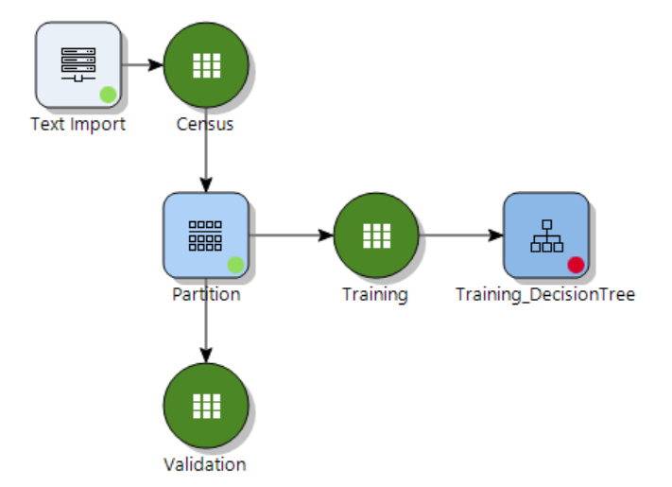
Modeling set up in Knowledge Studio
Import the Census file and then partition the file into training and validation datasets
Connect the decision tree node to the training dataset

Slide 12
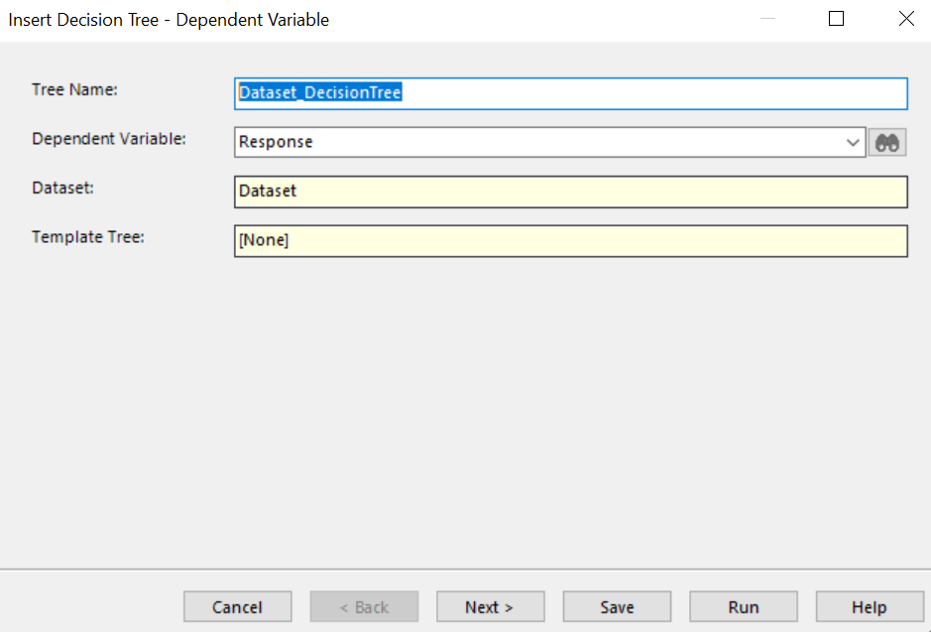
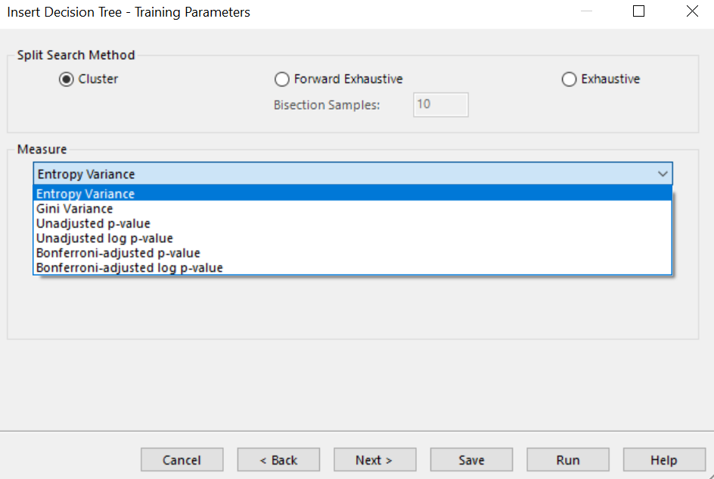
Decision Tree in Knowledge Studio – Create a new Tree
The first wizard page is about the Dependent Variable where users have to:
Input decision tree name
Choose a dependent variable from the drop-down menu
Template Tree option will be available (only) if an existing tree is connected to this tree node on the canvas
In the second wizard page, users are given the choice to set the training parameters in the Training Parameters wizard
Options include setting the split search method and measure
Specify split and measure
Notes:
*****Tree development is done on training dataset – i..e: 70% of 16,281 --- The details of these methods can be found in the help pages. We won’t discuss them here, other than to recommend the default
CHAID Family
Unadjusted – Raw P-value Measure
Adjusted – P-value Bonferroni Adjustment
CART Family
Entropy Variance - Non P-value Information Gain
Gini Variance - Non P-value Gini Measure
Unadjusted – Raw P-value Measure
Based on Chi-Square statistic
Maximises significance using on p-value of chi-squared test
Adjusted – P-Value Bonferroni Adjustment Measure
Same as above, but includes a Bonferroni adjustment based on number of comparisons
Entropy Variance – non P value: Entropy 0-1, 1 indicates high dispersion, 0 indicated low dispersion
C5 variant
Calculates split entropy, value between 0 and 1
Lower entropy means information gain
Gini Variance: 0-1, 1 indicates high dispersion, 0 indicate low dispersion
Calculates Gini index for the split
Lower index means lower dispersion and higher homogeneity

Slide 13
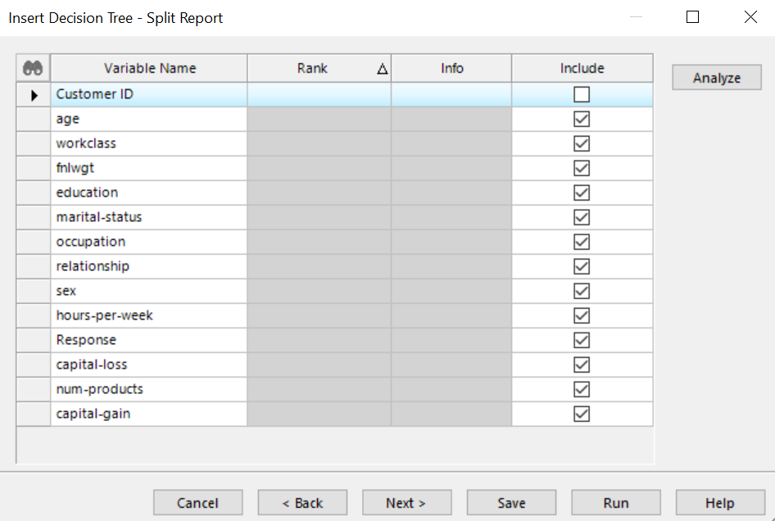
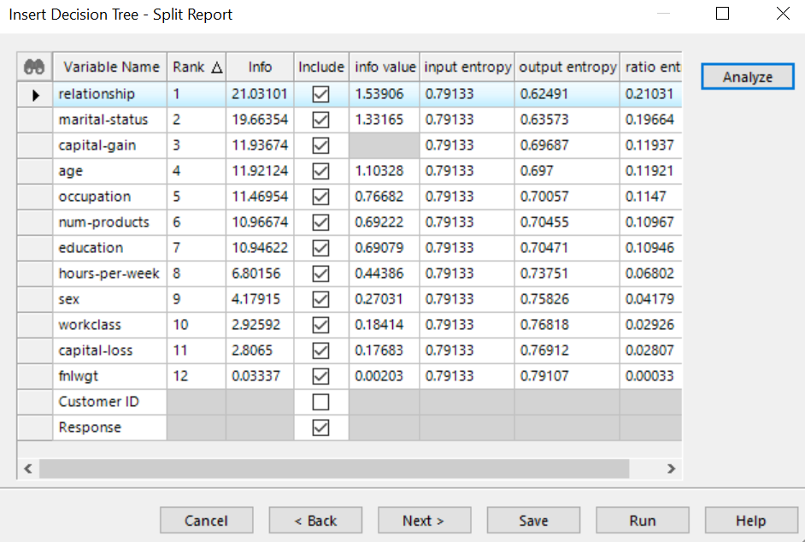
Decision Tree in Knowledge Studio – Exclude Unwanted Variables
This page can be used to exclude unwanted variables – it’s not necessary to do so, but may make things cleaner/easier later on
Excluded Customer ID in this example
Clicking Analyze button calculates some measures of predictive power, and ranks the variables accordingly
Include option
Analyze feature displays metrics

Slide 14
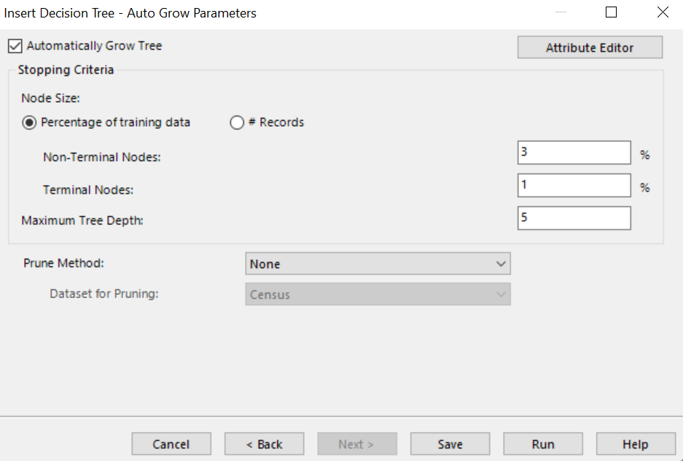
Decision Tree in Knowledge Studio – Auto Grow Parameters
One method of building out the tree is through the Auto Growth feature
Users need to input various parameters:
Node size – based on the % of training data or # of records
Options would be slightly different if choosing either option
Non Terminal nodes
Nodes which are split further
By default, should contain at least 3% of total population size
Auto Grow
Can Edit

Slide 15
Decision Tree in Knowledge Studio – Auto Grow Parameters
Terminal nodes
Nodes which are not split further
By default, should contain at least 1% of total population size
Maximum tree depth – maximum # of levels
Default percentages can be set in Tools|Options|Tree Growth menu
We will explore the Attribute Editor in the next few slides
Auto Grow
Can Edit

Slide 16
Decision Tree in Knowledge Studio – Attribute Editor
The Attribute Editor allows you to modify variable attributes used for decision tree development
The attribute values can be set and modified when inserting the tree in the tree wizard or modified after the tree has been developed
The Attribute Editor enables users to change:
If a variable is included or excluded
The role of variables in the model (i.e. dependent, independent, or weight)
The variable type (i.e. nominal, continuous, discrete)
P-value used to determine variable significance
Number of default bins for each of the variables
How values of a variable are treated (i.e. as ordered or not)
The display of grouped values of numeric variables (i.e. intervals or as discrete values)
Treatment of missing values

Slide 17
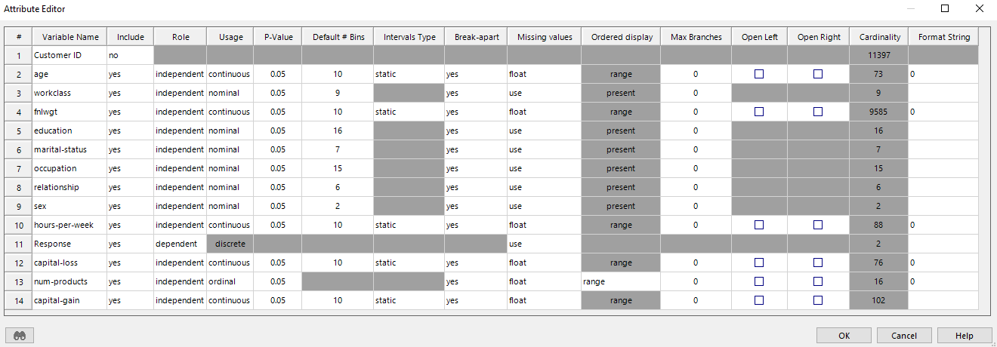
Decision Tree in Knowledge Studio – Attribute Editor
Variable Name: Independent variables in the dataset – potential variables used in decision tree
Include: Determines if a variable is to be included in the tree development process
Role: Determines the role of a variable is used in the tree (e.g. DV, IV, Weight)
Usage: Treatment of variables with available options: no binning, ordinal, nominal, continuous
Intervals Type: Defines how binning is performed for the continuous variables. Options are Static (compute bins once at the root node only) or Dynamic (compute bins optimally at every split)
Notes:
Role:
Dependent: Indicates that this variable is the dependent variable, or the variable that you want to explore. There can only be one dependent variable (DV).
Independent: Indicates that this variable should be compared to the dependent variable to determine if it has predictive value.
Weight: Indicates that this variable should be used as a weight that controls how much emphasis each record should be given in the analysis.
Usage: Algorithms can treat values in a number of ways.
No binning: Each category within the variable will form its own separate node in the tree. The search for similar groupings is turned off.
Ordinal: Treats values as an ordered set (e.g., 1-low, 2-medium, 3-high or 1, 2, 3). Only adjoining values will be grouped together when an algorithm is looking for similarities. For example, 1-low can be paired with 2-medium, or 2-medium can be paired with 3-high but 1-low cannot be paired with 3-high.
Nominal: Values combine freely. For example, red may combine with blue or green. All possible groupings of field categories are examined so that similar items are grouped together to become a node in the tree.
Continuous:
a) For independent variables: The variable is binned into intervals, which can be calculated in a number of different ways, based on your selections in the
Intervals Type column.
b) For numeric dependent variables: The numeric DV is considered as a continuous quantity, and instead of its individual values the tree nodes show the average and standard deviation of its values.
Discrete: Available only for the dependent variable. This option allows you to treat a numeric dependent variable as discrete: Show all its values as discrete categories instead of treating it as continuous (showing Average and Standard Deviation in the nodes).
Intervals Type: This option affects the Find Split and Automatic Grow operations and applies only to the variables with continuous Usage.
Static: The binning map for the variable is precomputed at the root node. The intervals remain static throughout the tree.
Dynamic: The binning map for the variable is calculated dynamically at every node.
Although the Static type is the default, the Dynamic type provides more intelligent mapping and is therefore recommended in most cases. Note that splitting a variable with dynamic interval type is up to two times slower than with the static type, but this may not be noticeable on fast computers.

Slide 18
Decision Tree in Knowledge Studio – Attribute Editor
P-value: Defines the level of confidence required to merge values into groupings
Default # Bins: Number of segments used to split variable
Break-apart: Allows growing tree optimally by considering either speed or accuracy
Two settings: Yes, gives the most accurate results. No, used when you have variables with many categories and you want to speed up analysis. Results may not be optimal.
Notes:
p-value: A low setting (0.001) will tend to produce few branches (splits) from each node, whereas a high setting (0.20) will produce a bushy tree with more branches. The default setting is 0.05. With a p-value setting of 0.05 you would typically only be wrong considering values as category components 5 times out of 100. Similarly, a setting of 0.001 will assure you that you have a 99.9% accuracy in the category assignments but that you will also have fewer resulting categories. A setting of 0.20 would result in more branches but with less certainty of the accuracy (80% confidence).
Default # of Bins:
- If Usage is continuous, the value in this column determines the number of intervals for the selected variable according to the following rule: To form splits in a decision tree, continuous values are initially divided into discrete intervals where each interval has approximately the same number of observations. These discrete intervals are then treated as ordered and combined accordingly. The number specified here determines how many initial intervals are formed for this continuous variable prior to the ordered grouping. Therefore, the resulting number of nodes may be less than or equal to the value in the Interval column. For example, if Interval=8, the resulting number nodes can be less than or equal to (<=) 8.
(See the topic "About Intervals/Bins" for details.)
- If Usage is nominal, the value in this column determines the maximum number of categories (bins) to display for the selected variable. The default value is equal to the cardinality or 50 (whichever is less). You may enter any integer number between 1 and the cardinality of the variable. If the maximum number of bins N is equal to the cardinality of the variable, then each of its values is represented as a separate category. If N is less than the cardinality, the following mapping is applied: the first N-1 unique values are represented as separate categories and the rest are mapped into one category denoted by triple number sign ("###").

Slide 19
Decision Tree in Knowledge Studio – Attribute Editor
Missing Values: Allows you to specify how missing values are handled in the tree development process. The effect and applicability of the missing value options depends on the variable role (independent, dependent or weight) and usage.
Ordered Display: Allows you to define how ordered variables are displayed. There are three options: Present, All, Range
Notes:
Missing Values:
1. For the dependent variable (DV):
Use (applicable to discrete DV only): Missing values are treated like any other value of the DV. More precisely, a missing value will be considered a separate DV category designated as null and will be shown in every node together with other DV values. This option is not applicable to continuous DV.
Ignore: All records containing missing values in the dependent variable will be excluded from the analysis. Note that in this case the root node will contain fewer records than the parent dataset.
If the DV of a Decision Tree is continuous, the records with missing values in the DV are always excluded, so Ignore is the default and the only available option for continuous DV in Decision Trees.
This does not apply to Strategy Trees.
(Note that if you ignore missing values in the DV, it will affect all tree views except for the Data tab. which will still show records with missing values in the DV. (The Data tab always shows the actual raw data for any selected node, which is determined by the node rule only, not by the settings in Attribute Editor)).
2. For the independent variables (IVs):
Use:
a) For variables whose Usage is "nominal" or "no binning", the use option is the default. When it is selected, the missing value is considered one of the regular categories of the variable and will be used just like any other discrete category when calculating the split.
b) For variables whose Usage is "ordinal" or "continuous": When the Find Split algorithm calculates the split, records with missing values participate in the process of calculating the bins from the very beginning.
Missing values are displayed as null in the tree view, the Range Editor of Force Split and Edit Split,etc.
Ignore: Missing values in the independent variable will be ignored. This means that any split on this variable will not include the condition "IF <variable_name> is NULL", so the child nodes in this split will not contain records with missing values in this variable. Note that in this case the sum of the numbers of records in the child nodes of a split will not necessarily add up to the number of records in their parent node.
Float: Missing values in the variable will not be used to calculate the split, but will then be grouped with the branch (child node) that presents the most similar behavior in terms of the target (DV) distribution. This option is the default for continuous and ordinal independent variables.
Missing values are displayed as null in the tree view, the Range Editor of Force Split and Edit Split,etc
3. For variables used as weight: Not applicable.
Ordered Display:
Present: displays all values which are present in the node. If a particular value of the variable is not present in the node, it will not be listed.
All: displays all values that fit within the range in the node, whether they are present in that particular node or not. For example, if a node contains the values 1, 2, 4, and 5 (and the value 3 exists somewhere in the dataset), the value 3 will be listed for the node.
Range: displays values as a range. For example, if a split groups the values 1, 2, 3, and 4 together, the values will appear as [1, 4].

Slide 20
Decision Tree in Knowledge Studio – Attribute Editor
Max Branches: Maximum number of branches produced by Find Split option
Open Left: Splits created by the IV are not bound by the minimum data values found in dataset
Open Right: Splits created by the IV are not bound by the maximum data values found in dataset
Cardinality: Shows number of unique values of the variable
Format String: Allows specifying various formats and precision for displaying values in the tree
Notes:
Max Branches: For example, if you want Find Split to produce binary splits for a specific independent variable, specify "2" in the Max Branches column for this variable. If you want to grow a binary tree (i.e., a tree with binary splits only), enter "2" in the Max Branches column for all variables.
Note that this setting does not apply to the Force Split operation. Also, note the difference from the Default # of Bins attribute. The Find Split algorithm starts calculating the split with the number of branches determined by Default # of Bins value. As opposed to Default # of Bins, Max Branches never leads to the creation of the other ("###") category for discrete variables.
Format String: (such as currency, percent, etc.) You can either choose one of the standard formats from the Format String drop-down list or enter a custom format. For detailed description of format strings, see Specifying Format.

Slide 21
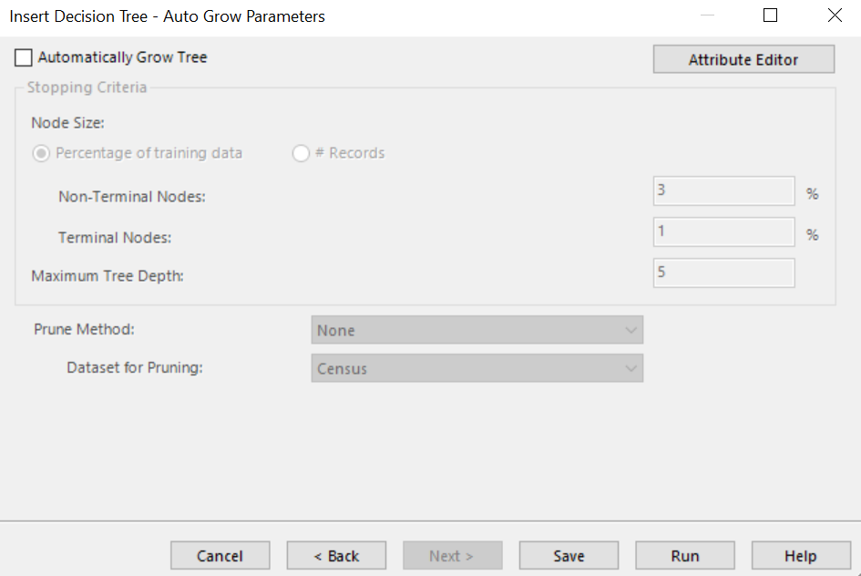
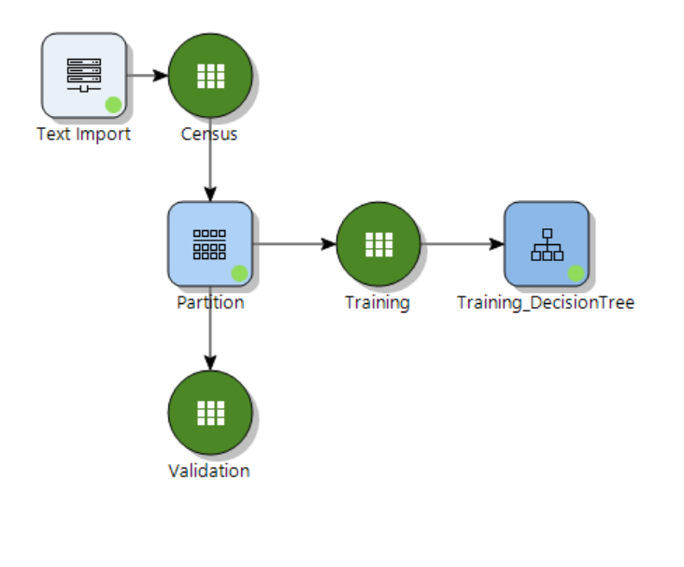
Decision Tree in Knowledge Studio
Going back to the Auto Grow Parameters wizard and clicking Run generates the decision tree on the workflow (note: we're not using Auto-grow here...things are slightly different when Auto-grow is used)
Double click the decision tree to work with it

Slide 22
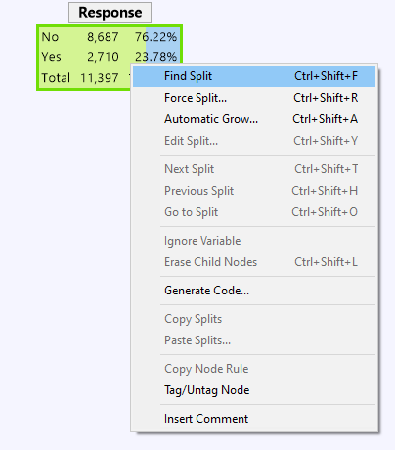
Decision Tree in Knowledge Studio
The root node in the tree shows the distribution of the dependent variable Response in the dataset
23.78% of the population responds to the marketing campaign while 76.62% does not respond
Right clicking on the node gives options to build out the tree further
First option is Find Split. This method searches for the IV that is most significant to the DV based on the criteria defined previously within the wizard.
Next option here is Force Split
This fully manual method allows custom splitting on IV of choice.
Automatic grow is the third available option here to build out the tree. Choosing this option will give you a pop-up with some Auto Grow parameters to specify before the tree is automatically grown
Root Node

Slide 23
Decision Tree in Knowledge Studio
To build out the tree, we click on Find Split to find the most predictive variable of Response
The variable Relationship appears to be the most predictive
Anyone who is in the Husband/Wife category is much more likely to respond ‘Yes’ to the marketing campaign in comparison to someone who is in the Unmarried category for example
We can also further build out the tree by finding splits on each of the child nodes, similar to how we found the split for those in the Other-relative/Own-Child category
Finding split on Other-relative and Own-child

Slide 24
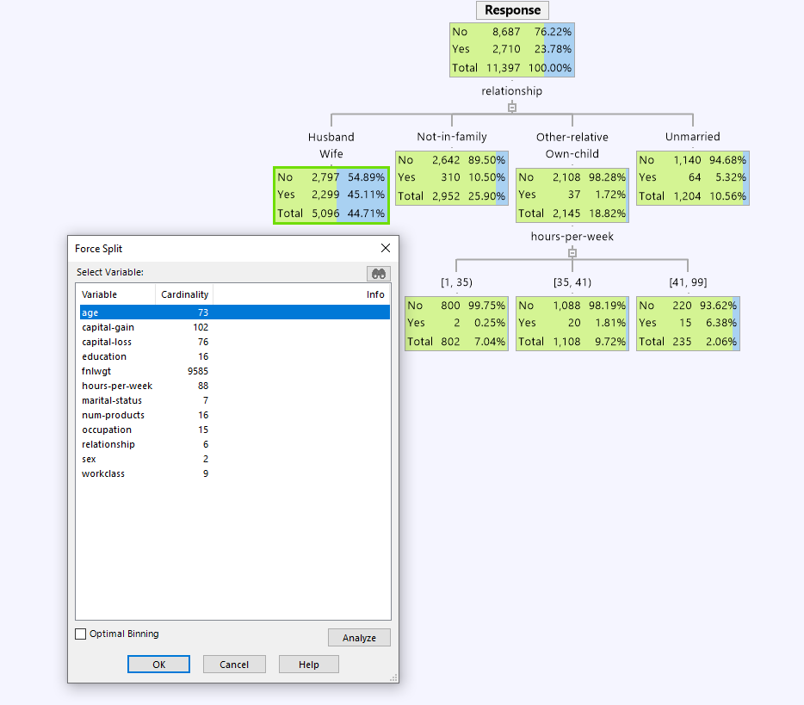
Decision Tree in Knowledge Studio
Force split Husband Wife segment on age
Another option to build out the tree is through Force Split
Allows the user to pick a specific split regardless of how useful that split is. Allows user to:
Incorporate business intuition
Impose operational imperatives
Can build a tree from scratch with force split options, or force a split on any of the nodes in a decision tree already built
When forcing a split you will be prompted to choose your own binning. You can start with "optimal binning", but will still be given the option to manually change the binning when creating the split

Slide 25
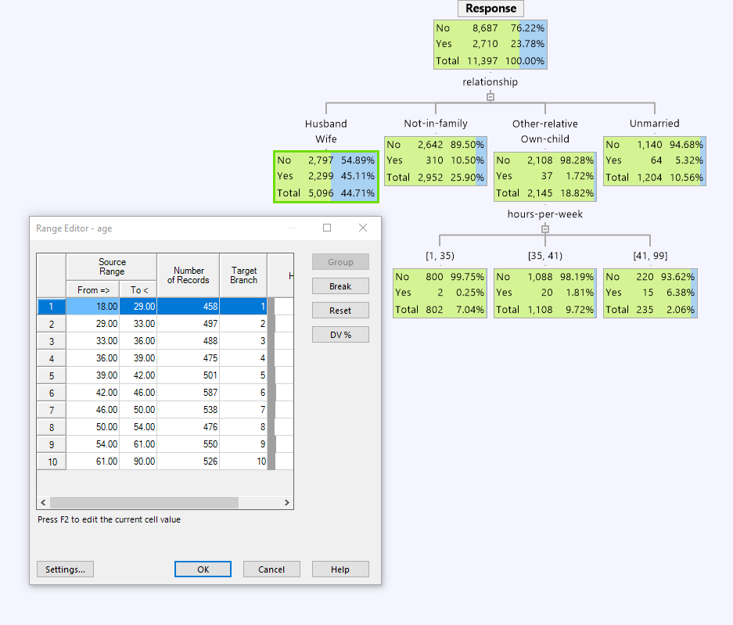
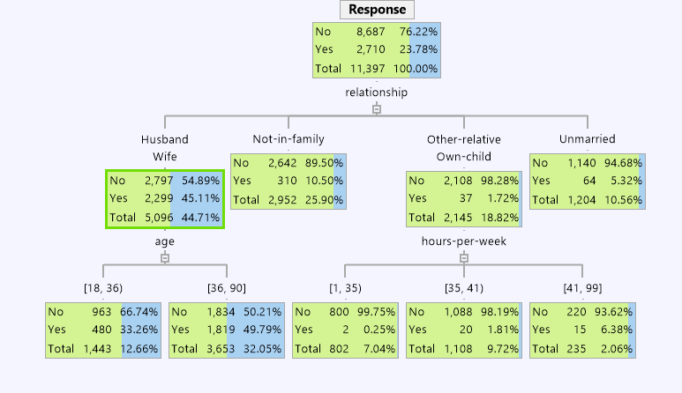
Decision Tree in Knowledge Studio
Once a variable is selected for force splitting, the Range Editor wizard appears
User here has the flexibility to:
Change the bins by manually editing the ranges
Grouping/breaking bins
Want to group anyone younger than 36 in one category and anyone older in one category

Slide 26
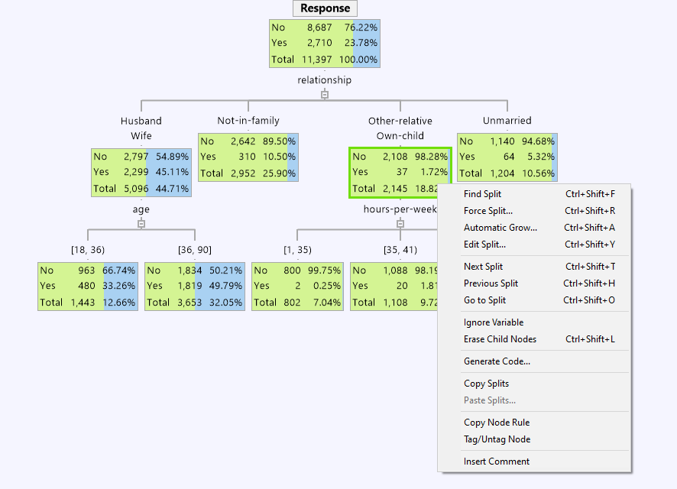
Decision Tree in Knowledge Studio
User also has the options to:
Edit a split
Go to the next split – next best predictor for that node
Go to the previous split
Go to any split from the list of available variables
Ignore a variable all-together from the analysis
Erase child nodes – to remove splitting on the variable
Copy split from a node in the tree and paste it on any other node

Slide 27
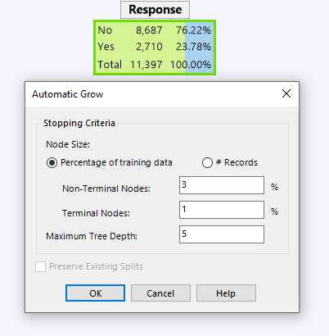
Decision Tree in Knowledge Studio
Automatic tree growth is another available option
Users will need to input stopping criteria to help prevent tree from over-fitting
Node Size as a % of training data or # of records
Non-Terminal node size as a % or # of records
Terminal nodes to contain at least % or # of records
Maximum Tree Depth to specify the maximum number of levels in the tree
Users also have the option to preserve existing splits if the tree building process has already been initiated
Automatic growth criteria

Slide 28
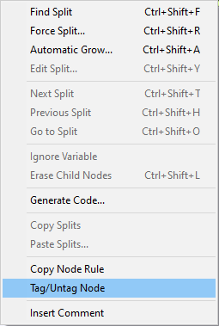

Node Tags
Another right-click option is to Tag or Untag a specific node
Tagging nodes will cause a green checkmark to appear on the node
This is a visual indicator of which nodes are tagged
Tagging nodes will allow the user to refer to a specific set of nodes (the tagged nodes) for other functionality later

Slide 29
Decision Tree Considerations
When building a good decision tree model, a few characteristics should be considered:
Robust
Meaning model generalizes well and does not overfit the training data
Tree should be pruned to have adequate node size and a reasonable number of branches
Accurate
Terminal nodes are predominantly concentrated in one category
Further splits in the tree homogenize the dependent variable target category
Simple
A good decision tree should be easy to use
Common practice is to have a maximum depth of 5, and at most 50 terminal nodes. This will vary somewhat depending on data size and specific situation
Explainable
The characteristics that make it into the model should always make sense
Notes:
Note however, some of these characteristics are at odds with each other…

Slide 30
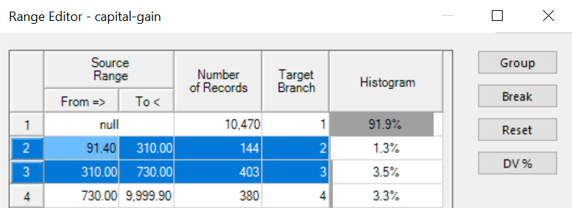
Improving the Model – Robust
What does robust mean?
Model should be stable and perform well on new data
Minor changes to model parameters should not cause major changes to the model
Some tips for a robust model:
Prune nodes to avoid small node sizes and large branches
Terminal nodes should contain an adequate number of records to avoid over-fitting
Recommendation: at least 1% to 2% of the training data in each node
Notes:
Over fitting is where our model predict our train data very well but it does not generalize well to any other dataset.
The way that it’s going to manifest itself in DT is very small nodes with few records. So small number of records are in a separate category.
To prevent overfitting the model, these small nodes can be merged with others or can be removed. This can be done by using ‘Edit Split’ function to merge nodes together.
As with very small nodes, very wide trees will lead to over-fitting. In general, a robust model should have six or fewer splits regardless of whether the tree is grown manually or automatically.
Just a reminder that if using Automatic Grow or Find Split the maximum number of branches can be set from within the Attribute Editor for one or more variables.

Slide 31
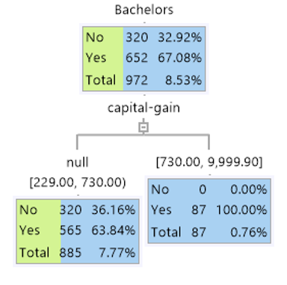
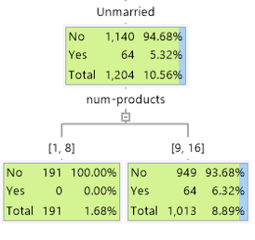
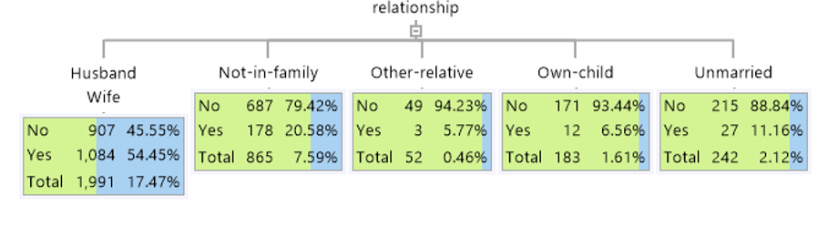
Improving the Model – Accurate
Avoid having pure nodes
Nodes do a good job of representing reality
Primarily about model prediction, but the idea of accuracy extends to data exploration as well
Some tips for creating accurate models:
Remember how decision trees make predictions
Nodes should concentrate cases into one of the DV categories
Pure nodes should be treated with suspicion. Can we see this pattern in real life?
Prune splits that do not better explain the DV than their parents

Slide 32
Improving the Model – Simple and Explainable
Simplicity is itself a virtue
Additionally, simplicity often encourages robustness and explainability
Models should be easy to understand and explainable
If this is not desired, decision trees might not be the best modelling choice
In general:
Trees with more than 5 levels are not usually considered simple or explainable
However, that does not mean all trees with less than 5 levels are simple
Assess splits during interactive growth or empirically if grown automatically

Slide 33
Viewing a Decision Tree in Knowledge Studio – Tabs
Various reports, maps and charts can be accessed from the decision tree node
Tree – displays the decision tree
Tree Map – simplified tree used for navigation and visualization
Node Data – displays the data contained within a selected tree node
Split Report – displays a statistical report of predictors evaluated at each split
Node Report – provides information about the terminal nodes in the tree
Charts – static or dynamic charts of single variables, cross tabulations or child nodes
Profile Chart – graphically displays node sizes and DV rates for each node
Parameters and Attributes – predictor variable parameters and attributes
Saved Charts – any charts of interest can be saved to this tab

Slide 34
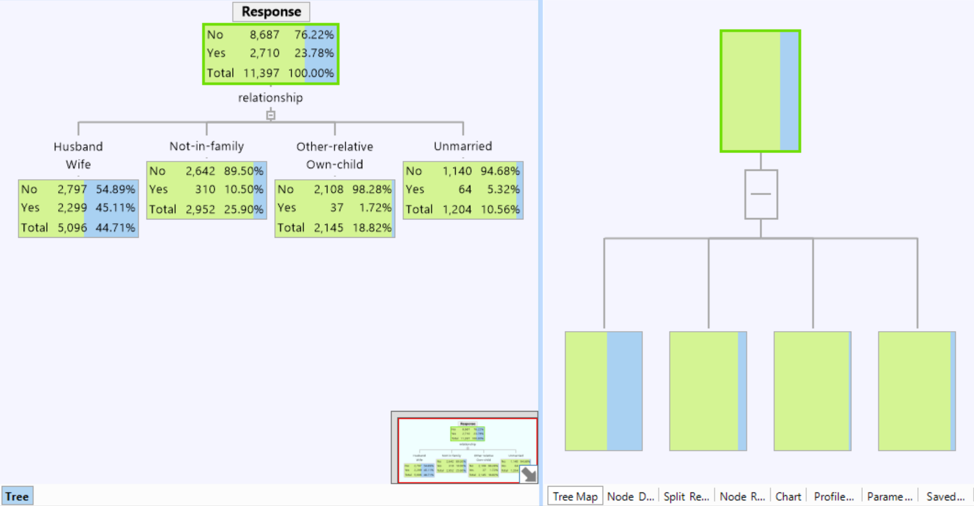
Tree and Tree Map Tabs
The tree map shown on the right is a simplified tree used for navigation and visualization
Useful for navigating large trees and identifying nodes of interest
Can easily navigate the tree through the tree map

Slide 35
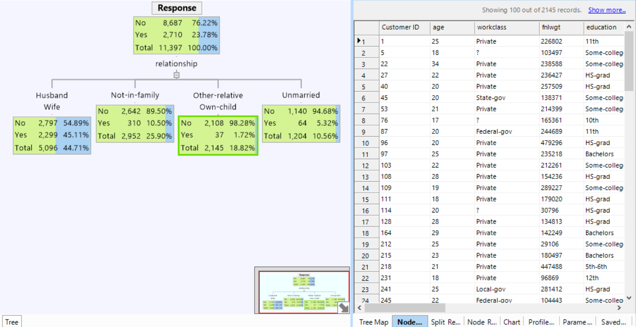
Node Data Tab
The Node Data view displays the data contained within individual tree nodes
Able to view node data

Slide 36
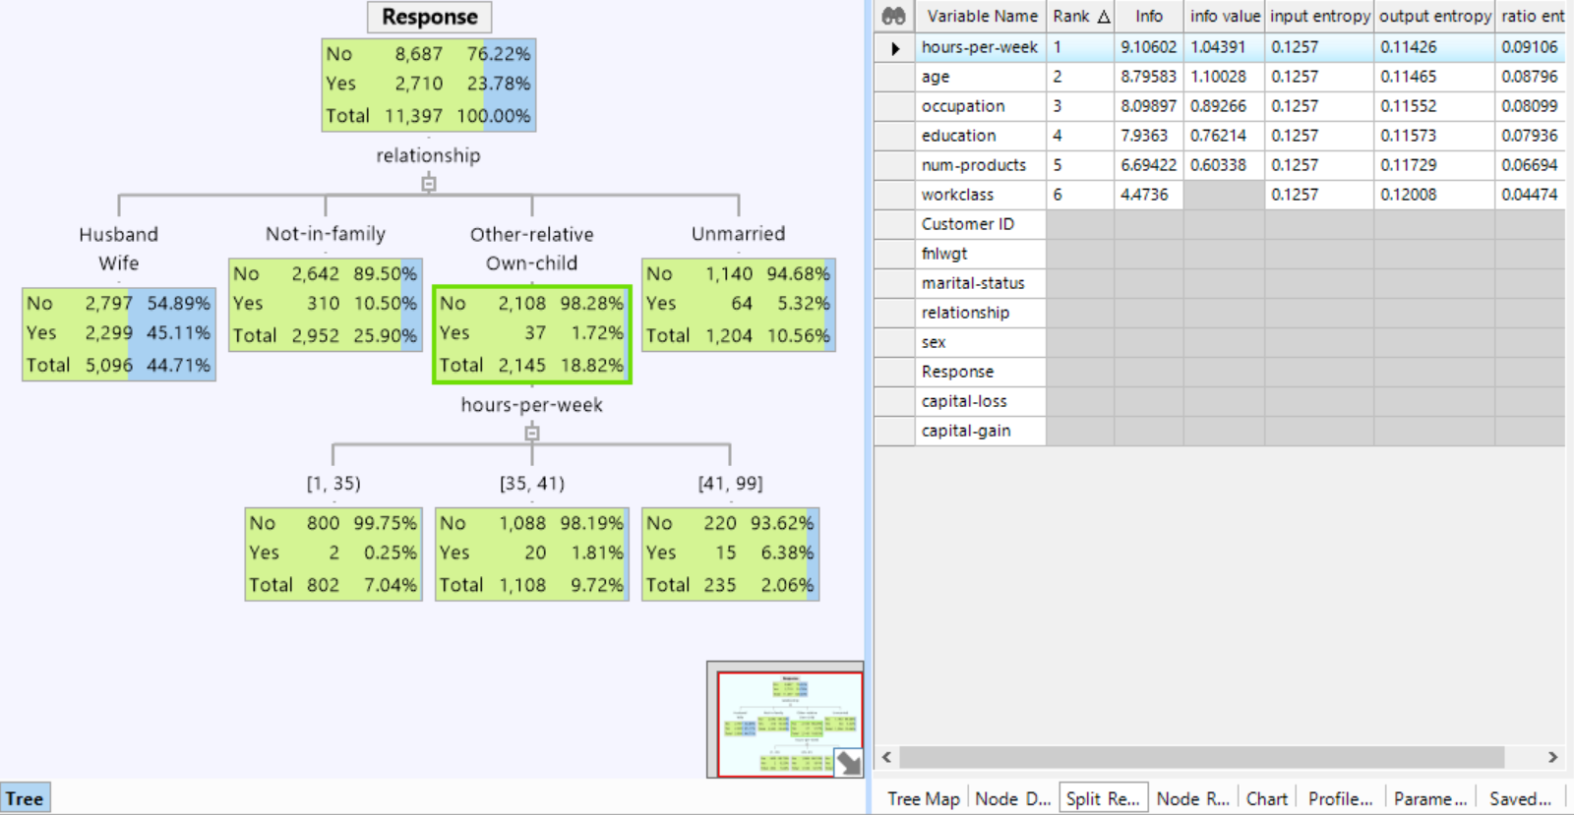
Split Report Tab
The Split Report displays possible splits at the currently selected node of the decision tree
The split report shows the calculated splits in rank order based on chi-squared values or other metrics
Able to see a ranked report of the possible variable splits at selected node

Slide 37
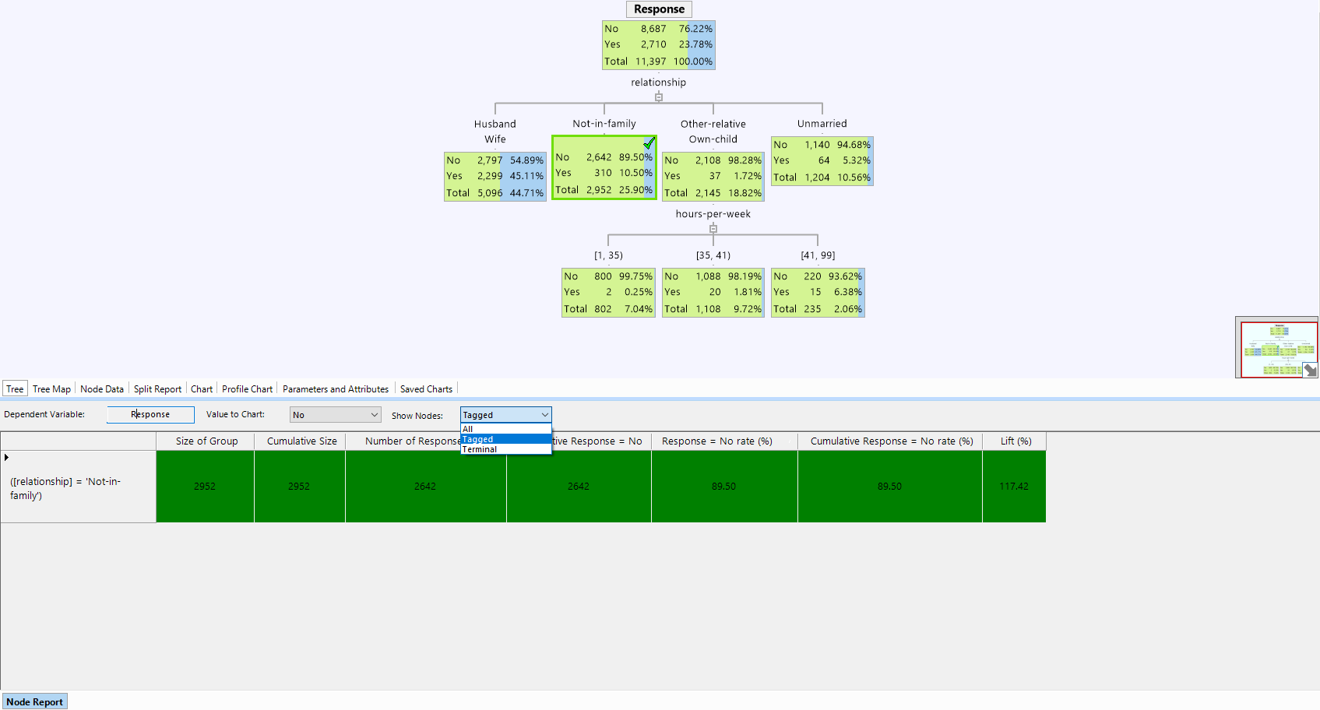
Node Report Tab
The node report provides information about nodes in the tree in the form of rules, sizes and ratios
Node report of terminal, tagged or all nodes by either category of DV

Slide 38
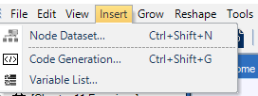
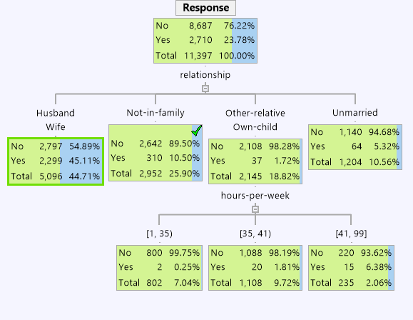
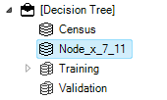
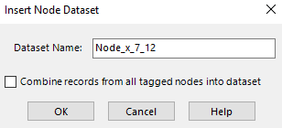
Node Data Export
Node dataset appears in project pane
To export a dataset of a desired node, highlight or tag the desired node;
From Insert, select Node Dataset
The dataset for the selected node will appear in the project pane
Modify

Slide 39
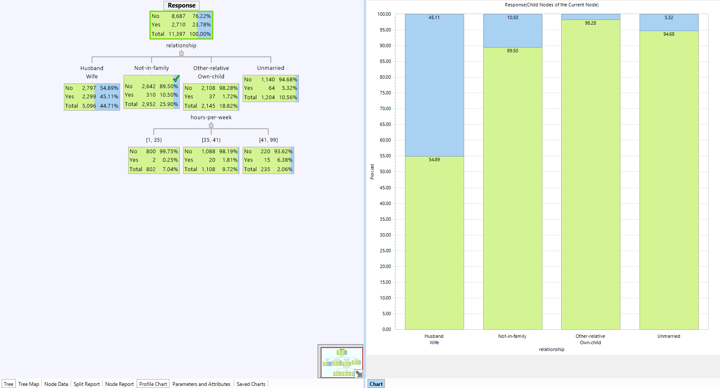
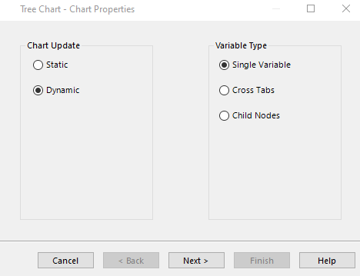
Chart Tab
Examine distribution within node dataset from Tools | Add Chart options
Option to include a static or a dynamic chart with single variable, cross tabs or child nodes option
We chose the dynamic and child nodes option here when selecting the root node – this means the chart will display the distribution of all the child nodes arising from this root parent node

Slide 40
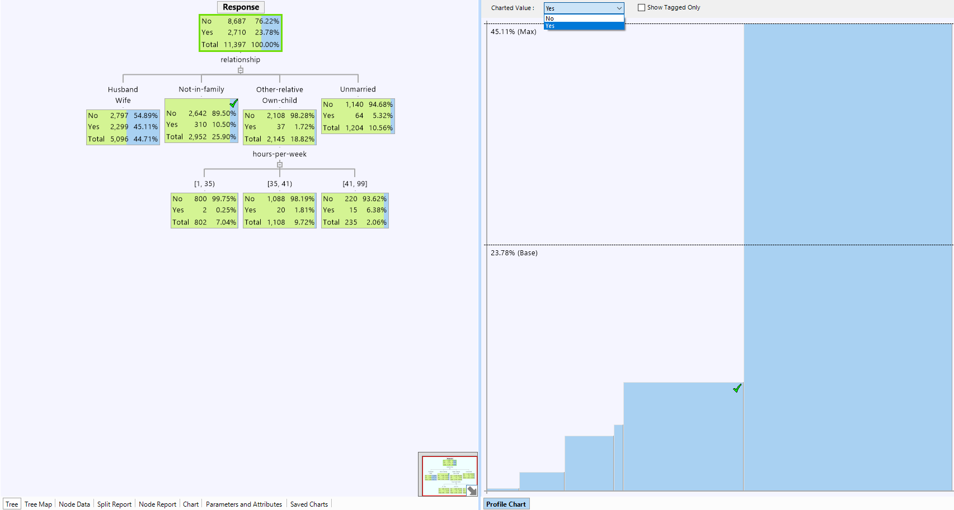
Profile Chart
Every bar represents a terminal node
Height represents the percentage of the category of interest
Width represents the size of the node
Option to graph either category of the dependent variable
Can also show tagged nodes only
Percentage of the category of interest in the root node

Slide 41
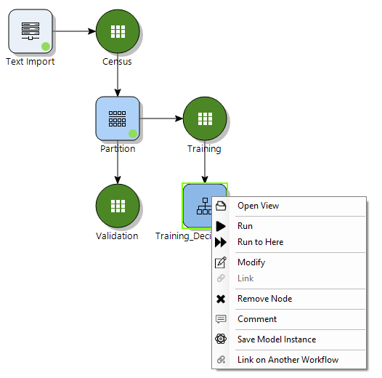
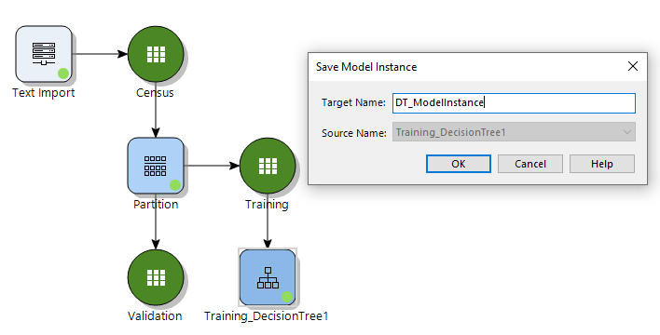
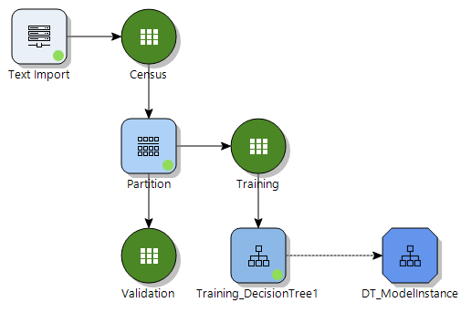
Saved Model Instance
Model Instances can be created to save specific instances of a given tree
To save a model instance, right click on your model of choice and select Save Model Instance
Because Trees are interactive, it's not always easy to recover a specific tree that has been carefully grown and pruned by the user
Using instances allows users to protect their interactive work from accidental changes or allows users to try out new trees without overwriting existing work
Tree instances won't be changed even if nodes upstream of the tree change, or the node is rerun – contrast that with tree nodes, where an interactively grown tree will be completely removed by rerunning the node
Model instance displayed on canvas

Slide 42
Chapter 8 Exercises (1/2)
If partitions do not already exist, create two random partitions using the Partition node. Create a Development partition and allocate 10,000 records to it. Create a Validation partition, and allocate 6,000 records to it
Create a Decision Tree by dragging a Decision Tree node onto the Workflow canvas
Use the Development partition to train the model by linking it to the Decision Tree node
Select the variable Response, as the Dependent Variable
Name the model appropriately
Use the default algorithm: Entropy Variance to develop the model
Open the Decision Tree. The first tab displays the tree view
Assess the dependent variable distribution
Use the taskbar icon or right click and choose Find Split to find the first split variable
What variable was chosen? Why? Refer to the Split Report tab to assess
Use Find Split on the resulting nodes to further build the tree
If any splits result in more than six child nodes use Edit Split to merge nodes together, use your judgement to assess which should be merged

Slide 43
Chapter 8 Exercises (2/2)
10. Explore the other tabs to assess the information they contain
Split the screen to have the model, some charts and the Tree Map visible simultaneously
Create a dynamic chart of a single variable, e.g. age. Click on any node to see the charts reflect the distribution of cases in the selected node
Return to single view
Use the Automatic Grow option to allow the algorithm to automatically grow the tree
Assess variable attributes using the Attribute Editor from the Tools menu to assess whether any variables should be excluded
Should all variables be used in building the model? Consider excluding the variable fnlwgt. Why?
Use the Force Split option and choose any variable to force a split. How does this differ from the other methods?
View the node report for a tabular representation of the tree
Explore creating more trees using a different algorithm, by modifying the Decision Tree node
Create a model instance. Assign an appropriate name

